Slide 1
Types of Operating Systems

Slide 2
Desktop vs Server Operating Systems
Desktop Operating System
Installed on a personal computer (PC) that is used by one person at a time
E.g. Microsoft Windows, Mac OS
Server Operating System
Usually installed on a more powerful computer that is connected to a network, and can act in many roles to enable multiple users to access information such as emails and files.
Microsoft Windows Server

Slide 3
Open Source vs Proprietary Operating Systems (Recap)
Open source OSs based on open, published source code that can be modified and improved by anyone. They are free of charge.
E.g. UNIX and Linux
For Proprietary OSs, the source codes are accessible only by the company that produced that OS, such as Microsoft and Apple.
E.g. Microsoft Windows and Apple’s Mac OS

Slide 4
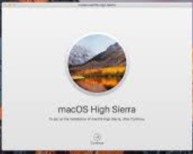


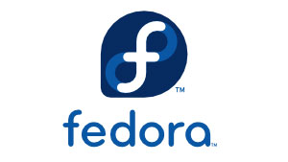
Current versions of Operating Systems (Recap)
Most common OSs fall into several families:
Windows 8, 10
Windows Server 2012, 2016
Different distributions of UNIX/Linux OSs, such as Fedora, Ubuntu, Redhat.
Apple Macintosh Mac OS X (versions 10.12 Sierra, 10.13 High Sierra)

Slide 5
Types of Operating System
Types of operating system can be broadly classified as:
Desktop vs Server
Open Source vs Proprietary
Multi-tasking vs Multi-user

Slide 6
Multi-tasking
A multi-tasking OS allows more than one program (also called task) to run at the same time in a computer.
A multi-tasking OS should be able to support user in:
Doing multiple tasks at the same time such as editing PowerPoint slides and surfing the Internet at the same time
Switching between the different active applications
Transferring data from one (running) application to another – e.g., moving a picture from a PowerPoint slide to a Word document

Slide 7
Multi-user
A multi-user OS supports multiple users logging into a computer system concurrently.
Tasks that a multi-user OS needs to handle include:
Fair treatment of users with similar privileges
Priority to super-users – users with high privileges
Privacy of users’ files and data sharing storages
Protection of integrity of each user’s programs and data from either malicious attempt to sabotage another user or accidental mistake by another user

Slide 8
Multi-tasking and Multi- user
Operating System | Multi-user | Multi-tasking
Microsoft Windows |  | √
Mac OS | √ (But only one user can use GUI at a time) | √
UNIX | √ | √
Linux | √ | √
Windows Server | √ | √

